Slide 1
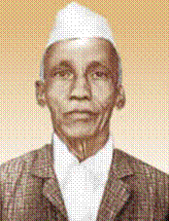
D. R. KAPREKAR
DRISHTI CHAUHAN 106021
VEDANG DIVEKAR 106027
REET SHARMA 106030
AYUSH KULSHRESHTHA 106031

Slide 2
DATTATREYA RAMCHANDRA KAPREKAR
D R KAPREKAR was born in dahanu, a town on the west coast of India about 100 km north of Mumbai.
He was brought up by his father after his mother died when he was eight years old.
His father was a clerk who was fascinated by astrology.
Although astrology requires no deep mathematics, it does require a considerable ability to calculate with numbers, and kaprekar's father certainly gave his son a love of calculating.

Slide 3
RESEARCH
Working largely alone, Kaprekar discovered a number of results in number theory and described various properties of numbers.
In addition to the Kaprekar's constant and the Kaprekar numbers which were named after him, he also described self numbers or Devlali numbers, the harshad numbers and Demlo numbers.
He also constructed certain types of magic squares related to the Copernicus magic square.
Initially his ideas were not taken seriously by Indian mathematicians, and his results were published largely in low-level mathematics journals or privately published, but international fame arrived when Martin Gardner wrote about Kaprekar in his March 1975 column of Mathematical Games for Scientific American.
Today his name is well-known and many other mathematicians have pursued the study of the properties he discovered.

Slide 4
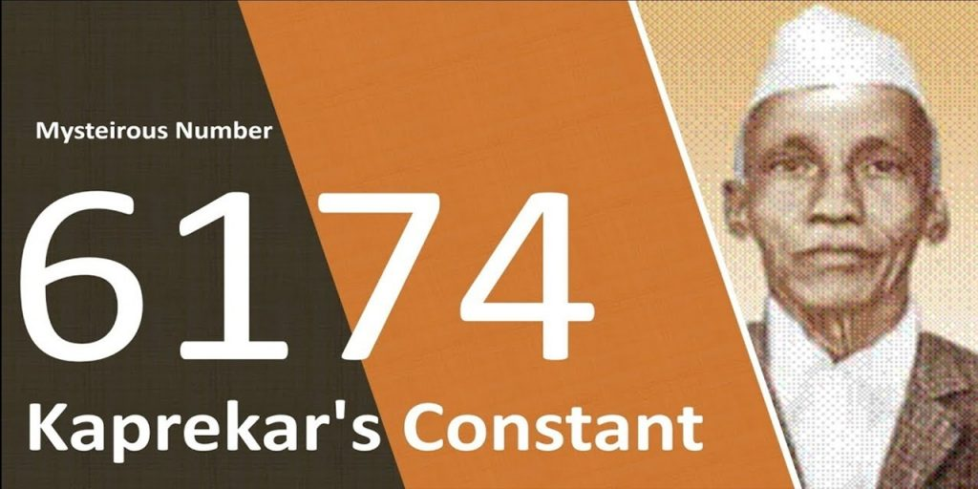
DISCOVERIES
Kaprekar's constant
Kaprekar number
Devlali or self number
Harshad number
Demlo number

Slide 5
KAPREKAR’S CONSTANT
In 1949, Kaprekar discovered an interesting property of the number 6174, which was subsequently named the Kaprekar constant. He showed that 6174 is reached in the limit as one repeatedly subtracts the highest and lowest numbers that can be constructed from a set of four digits that are not all identical. Thus, starting with 1234, we have:
4321 − 1234 = 3087, then
8730 − 0378 = 8352, and
8532 − 2358 = 6174.
Repeating from this point onward leaves the same number (7641 − 1467 = 6174). In general, when the operation converges it does so in at most seven iterations.
A similar constant for 3 digits is 495. However, in base 10 a single such constant only exists for numbers of 3 or 4 digits; for other digit lengths or bases other than 10, the Kaprekar's routine algorithm described above may in general terminate in multiple different constants or repeated cycles, depending on the starting value

Slide 6
CONTRIBUTIONS TO ENGINEERING MATHEMATICS
He made contributions towards various topics such as magic squares, recurring decimals, integers with special properties and much more.
This mathematician even has a constant named after him!
Kaprekar described various classes of natural numbers.
He derived several results in number theory and described numerous properties of numbers.
Kaprekar who mostly worked alone gradually became a known name in recreational mathematics circles.

Slide 7
AWARDS,HONOURS,TRIBUTES
He excelled, winning the Wrangler R P Paranjpe Mathematical Prize in 1927. This prize was awarded for the best original mathematics produced by a student and it is certainly fitting that Kaprekar won this prize as he always showed great originality in the number theoretic questions he thought up.
His claim to fame is the Kaprekar constant 6174. Start with any four digit number, with no repeating digits – say Z. Let A and B be two numbers formed by rearranging the digits of Z, such that A is the highest number that is possible, and B the smallest. Subtract B from A. If this is not 6174, continue the same way now taking this number to be Z.
For example, starting with Ramanujan number 1729: 9721-1279 = 8442 8442-2448 = 5994 9954-4599 = 5355 5553-3555 = 1998 9981-1899 = 8082 8820-0288 = 8532 8532-2358 = 6174 7641-1467 = 6174
He also gave the world Harshad numbers: numbers that can be divided by the sum of their digits – for example 12, which is divisible by 3.

Slide 8
REFERENCES
S P Arya, D R Kaprekar (1905-1986), Math. Student 55 (2-4) (1987), 241-243.
R C Gupta, D R Kaprekar - a birth centenary tribute (1905-1986), Indian J. Hist. Sci. 41 (2) (2006), 223-226.
D R Kaprekar, On Kaprekar numbers, J. Rec. Math. 13 (1980-1981), 81-82.
D R Kaprekar, On Wonderful Demlo numbers, Math. Stud. 6 (1938), 68.
D R Kaprekar, Puzzles of the Self-Numbers (311 Devlal Camp, Devlali, India, 1959).
D R Kaprekar, Demlo Numbers (Khareswada, Devlali, India, 1948).
S P Mohanty, D R Kaprekar : a life-long devotee of mathematics (1905-1988), Some eminent Indian mathematicians of the twentieth century, Vol. IV. Bull. Math. Assoc. India 18 (1-4) (1986), 42-53.
S P Mohanty, D R Kaprekar - a life-long devotee of mathematics, Bull. Math. Assoc. India 10 (1-4) (1978), 61-73.

Slide 9
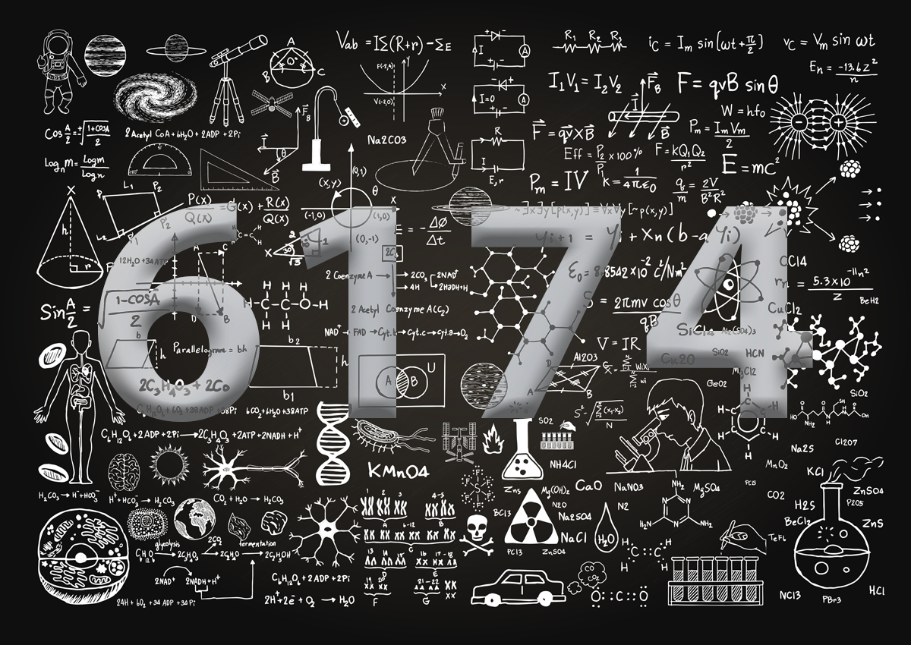
THE MAGIC NUMBER 6174

Slide 10

THANK YOU!

